Slide 1
STA591 - GROUP 3
Predicting Delays in Domestic Flights Operated by Large Air Carriers in the US.
Members:
Adefolu, Aminat
Esivwenughwu, Emmanuel
Joslin, Priscilla
Ofori Aboah, Valerie

Slide 2
Literature review
Primary data analysis method: Regression
““Network (delays)” measures the observed delays at individual airports, but cannot be attributed to local operations, because they have been incurred earlier in the day at upstream airports.”
“Results indicate that the long-term flight delays are mainly caused by network effects, while the short-term flight delays are strongly associated with local delays. Therefore, the existing factors such as temporal variables, weather condition and seasonal effects are replaced with specific novel factors (e.g. crowdedness degree of airport and air traffic system, demand-capacity imbalance) for flight delay prediction. “

Slide 3
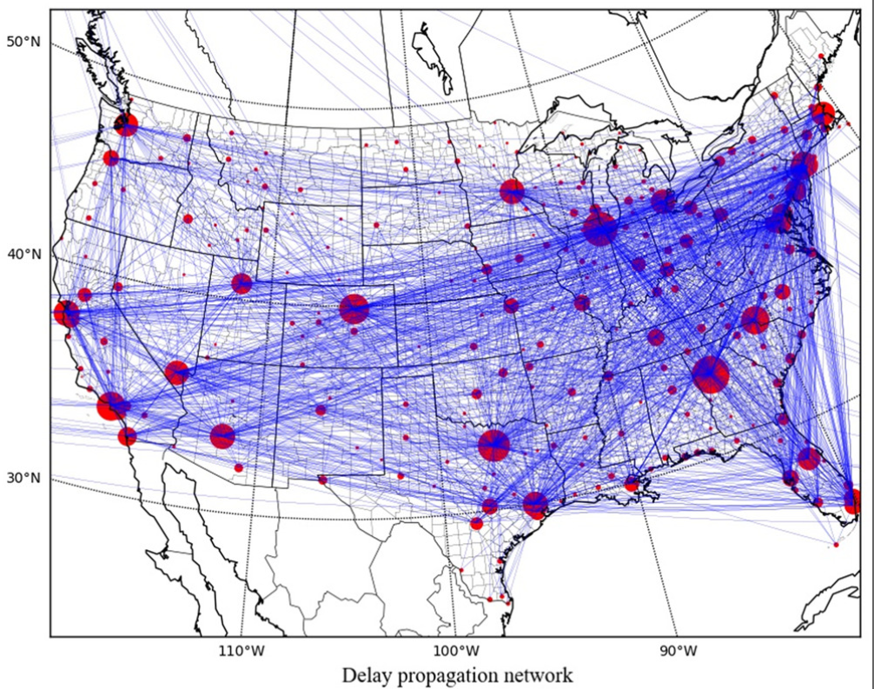
2018 Data Analysis of Flight Delays
Airport to airport propagation, edges represent the relationship of delay propagation between airport pairs, and the node size is proportional to its traffic flow
Li Q, Jing R. Generation and prediction of flight delays in air transport. IET Intelligent Transport System (Wiley-Blackwell). 2021;15(6):740-753. doi:10.1049/itr2.12057

Slide 4
PURPOSE OF THE PROJECT
The U.S. Department of Transportation's (DOT) Bureau of Transportation Statistics tracks the on-time performance of domestic flights operated by large air carriers. The purpose of this project is:
To identify the various factors (inputs variables) associated with the target variable (Delay_On_Arrival).
To develop predictive models and select the best one that accurately predicts whether a particular flight would be delayed using the factors considered in 1.

Slide 5
DATA SOURCES AND DESCRIPTION
The data was selected from https://www.kaggle.com/ which provides publicly available datasets ranging from various aspects of human endeavor and industries, medicine, travel, entertainment etc. The dataset we used is the 2015 Flight Delays and Cancellations which consisted of over 5 million observations and 31 variables which include AIRLINE, LATITUDE, LONGITUDE, ARRIVAL_TIME, DEPARTURE_TIME, WHEELS_ON etc.
The dataset can be found at: https://www.kaggle.com/usdot/flight-delays.

Slide 6
DATA CLEANING AND METHODS FOR VARIABLE SELECTION AND TRANSFORMATION
For this study, we restricted the year to only flight delays in 2015, and a total of 50,000 records was selected using simple random sampling.
Also, using the IF condition, a new binary variable (“Delay_On_Arrival”) was created based on the variable “ARRIVAL_DELAY”, where a number 1 was assigned if “ARRIVAL_DELAY” was greater than 15 and 0 otherwise. This made the total number of variables to be 32. In these 32 variables, we had 19 input variables, 12 rejected variables and 1 target variable. For level, we had 3 binary variables, 7 nominal variables, 2 unary and 20 interval variables.
This new variable (“Delay_On_Arrival”) was chosen as our target variable and since it gives the same information as “ARRIVAL_DELAY”, “ARRIVAL_DELAY” was rejected, using the default “Advanced Advisor settings”. Also, under the “Advanced Advisor Settings”, we made the Class Levels Count Threshold 20, and the Missing Percentage Threshold 50. This by default rejected variables that exceeded this threshold.

Slide 7
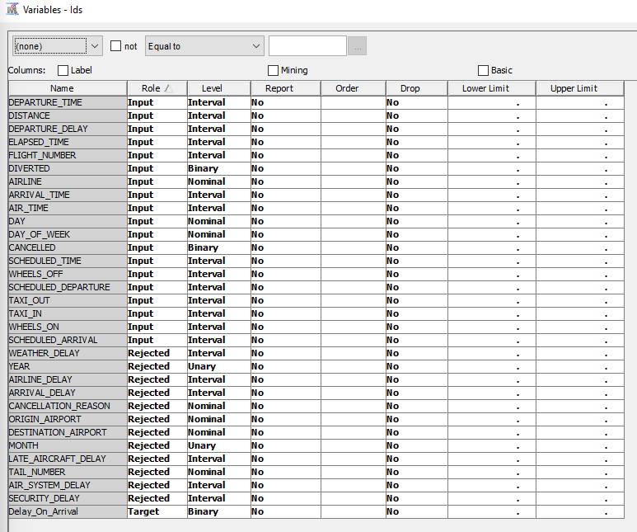
DESCRIPTIVE SUMMARY OF TARGET AND SELECTED INPUTS
Data Partition was done with Training: 50.0, Validation: 30.0, Test: 20.0

Slide 8
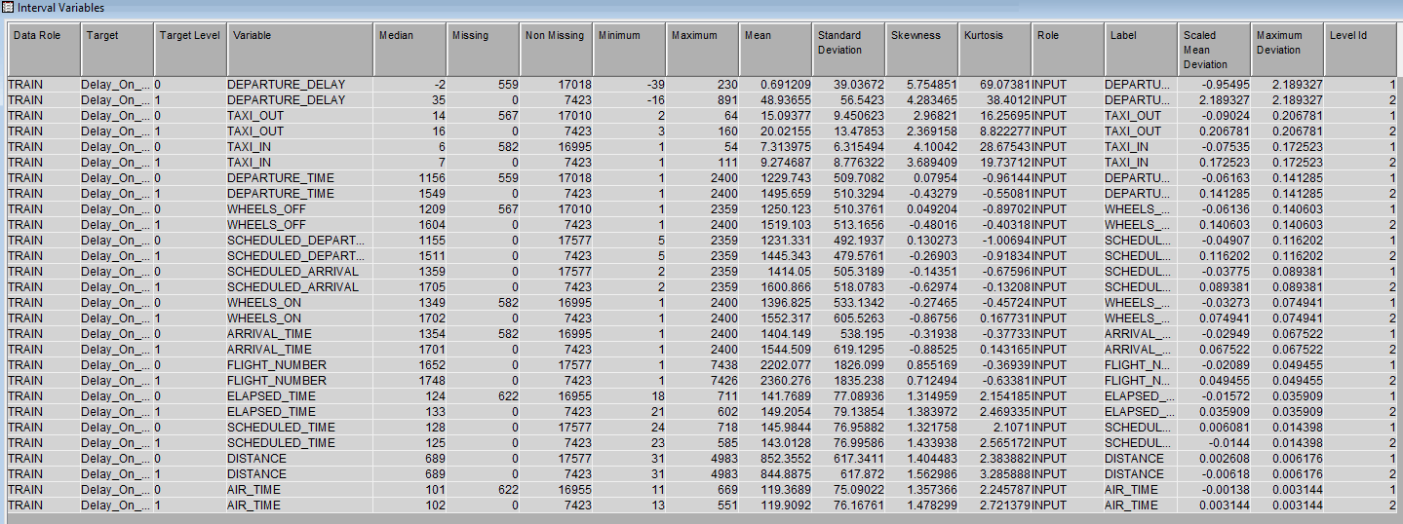
DESCRIPTIVE SUMMARY OF TARGET AND SELECTED INPUTS
The summary statistics of the Selected Input variables and the Target Variable from the StatExplore Node is shown:
Interval Variables:

Slide 9
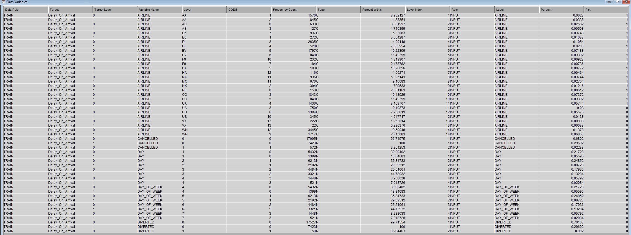
DESCRIPTIVE SUMMARY OF TARGET AND SELECTED INPUTS
The summary statistics of the Selected Input variables and the Target Variable from the StatExplore Node is shown:
Class Input Variables:

Slide 10
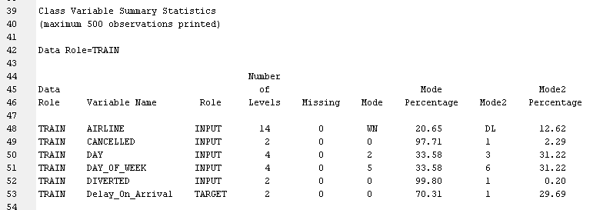
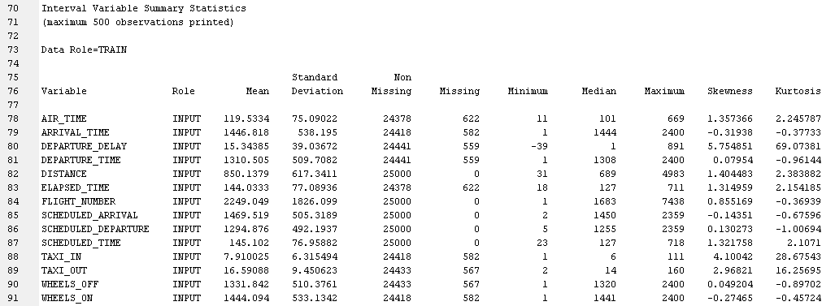
DESCRIPTIVE SUMMARY OF TARGET AND SELECTED INPUTS
The variable summary statistics from the output of the StatExplore is given below:
For the Class Variables
From the summary statistics for the class variables above, 2.29% of flights were cancelled, 31.22% of flights occurred on day_of_week 4 which is a Wednesday.
For the Interval Variables
From the summary statistics for the interval variables above, the average distance between airports is 850.1379 miles and the minimum distance between airport is 31 miles and maximum is 4983 miles.

Slide 11
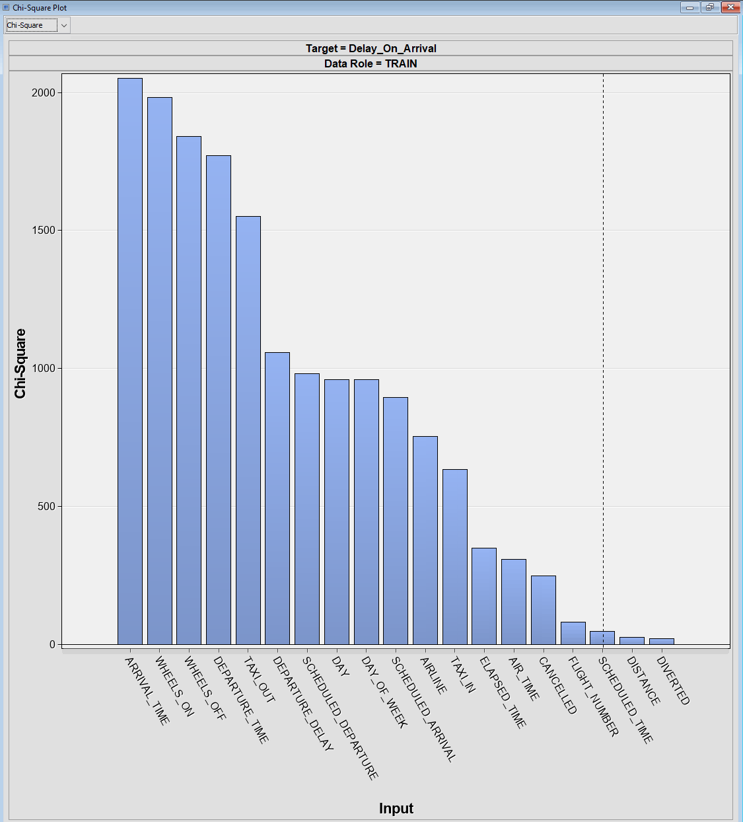
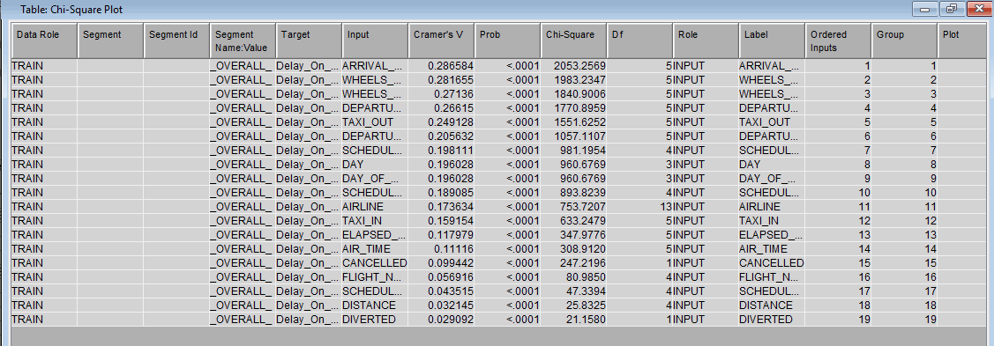
DESCRIPTIVE SUMMARY AND ASSOCIATION BETWEEN TARGETS AND SELECTED INPUTS
The Chi-Square graph and its corresponding table from the StatExplore node is shown below:

Slide 12
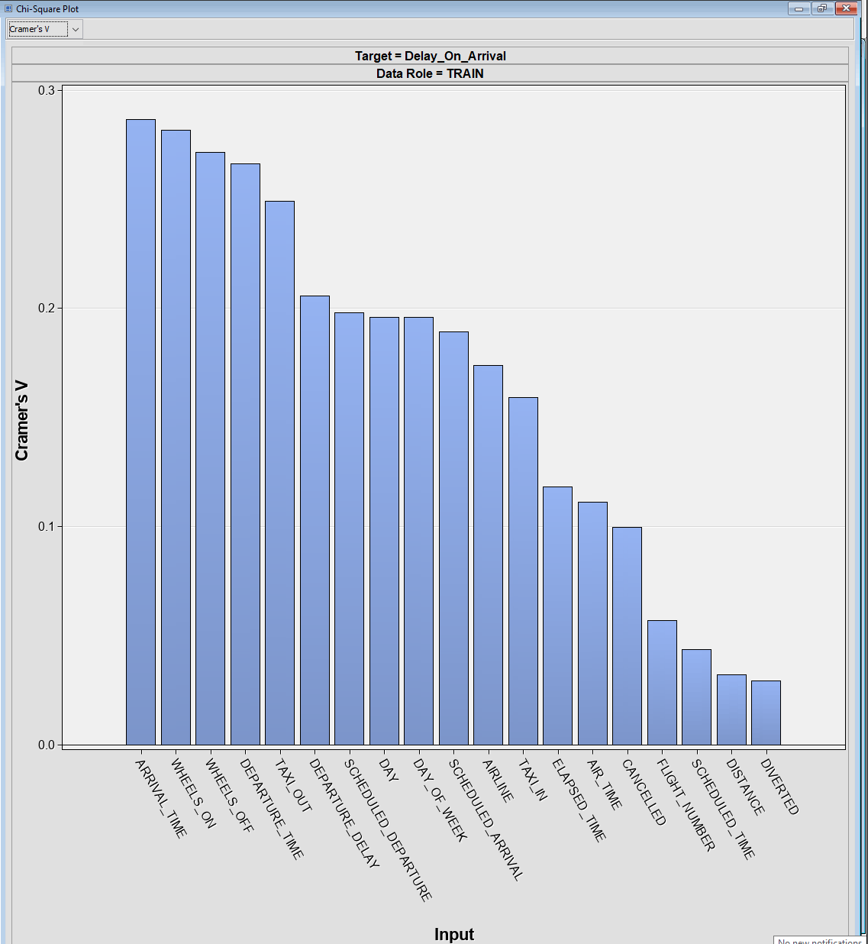
DESCRIPTIVE SUMMARY AND ASSOCIATION BETWEEN TARGETS AND SELECTED INPUTS
The Crammer’s V graph is shown below:

Slide 13
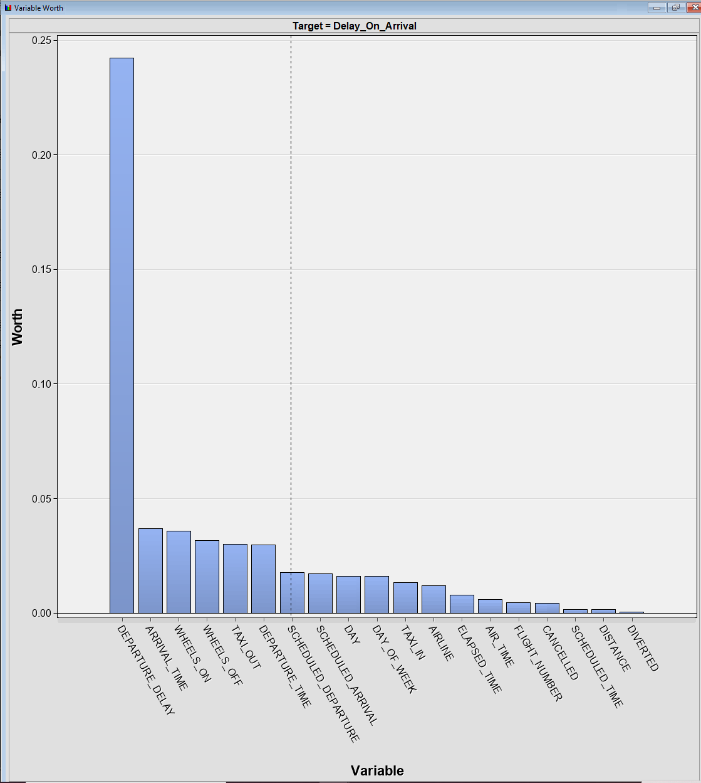
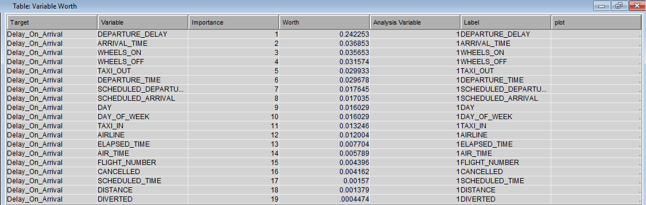
DESCRIPTIVE SUMMARY AND ASSOCIATION BETWEEN TARGETS AND SELECTED INPUTS
The Variable Worth graph and its corresponding table from the StatExplore node is shown below:

Slide 14
DESCRIPTIVE SUMMARY AND ASSOCIATION BETWEEN TARGETS AND SELECTED INPUTS
From the Chi-Square, Cramer V’s and Variable Worth’s plots of the StatExplore node, we see that the top seven input variables (which are consistent for the three plots) associated with the Target Variable (“Delay_On_Arrival”) in no particular order are:
DEPARTURE_DELAY
ARRIVAL_TIME
WHEELS_ON
WHEELS_OFF
TAXI_OUT
DEPARTURE_TIME
SCHEDULED_DEPARTURE

Slide 15
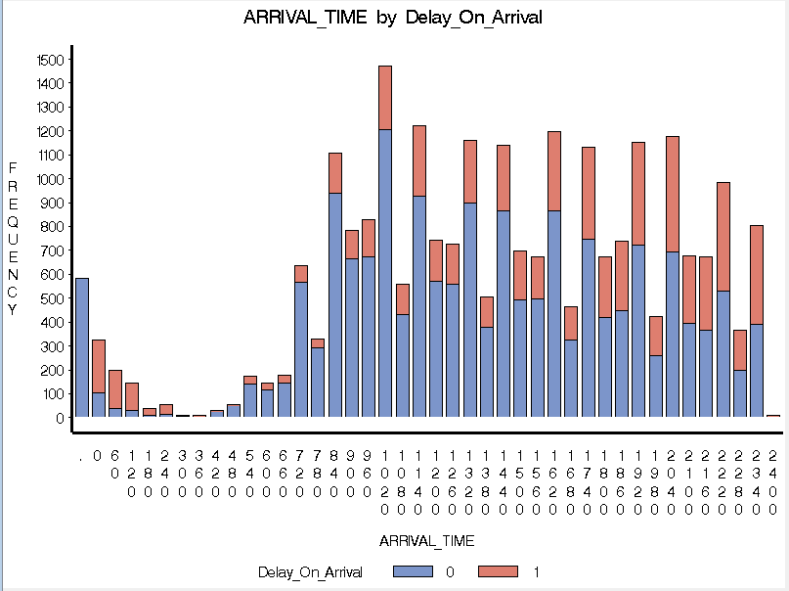
DESCRIPTIVE SUMMARY AND ASSOCIATION BETWEEN TARGETS AND SELECTED INPUTS
For the graphs of the MultiPlot node, we considered some of the mentioned Input Variables with that of the Target Variable (“Delay_On_Arrival”)
Here, we see that there is truly a difference in the ARRIVAL_TIME of the two levels of “Delay_On_Arrival”, which shows that this must be an important input that affects the target.

Slide 16
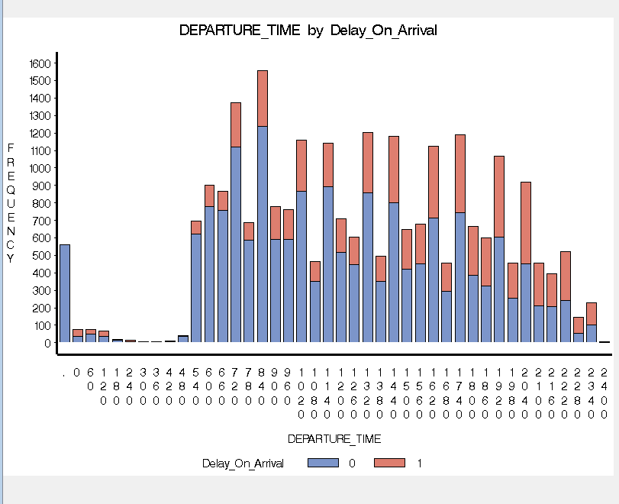
DESCRIPTIVE SUMMARY AND ASSOCIATION BETWEEN TARGETS AND SELECTED INPUTS
For the graphs of the MultiPlot node, we considered some of the mentioned Input Variables with that of the Target Variable (“Delay_On_Arrival”)
Also, we can see some differences in the two levels of “Delay_On_Arrival” for “DEPARTURE_TIME” , shown above.

Slide 17
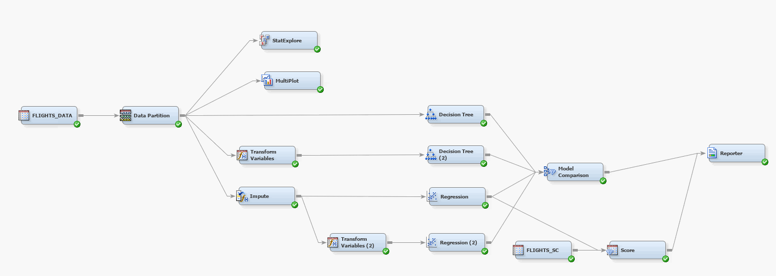
METHODS, RESULTS AND DISUCSSIONS
Project Diagram showing all nodes and all models considered

Slide 18
MODEL 1: DECISION TREE
MODEL SELECTION CRITERION FOR TREE GROWTH AND PRUNING
Splitting Rule (Growing the tree using training data)
ProbChisq
Pruning criterion (Method for selecting optimal tree size using validation data)
Method – Assessment
Assessment Measure – Misclassification

Slide 19
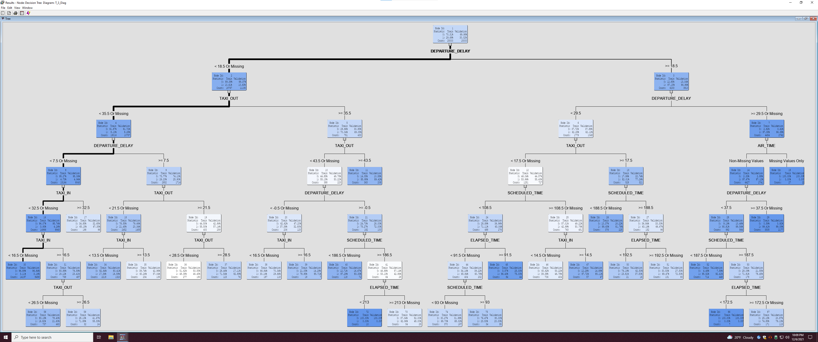
METHODS, RESULTS AND DISUCSSIONS
DECISION TREE MODEL
Tree Diagram

Slide 20
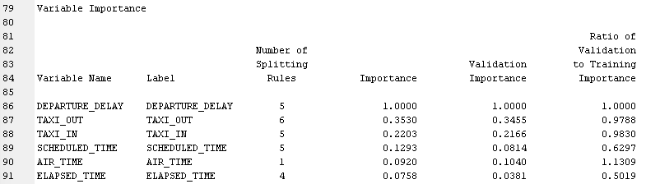
METHODS, RESULTS AND DISUCSSIONS
DECISION TREE MODEL
Variable Importance from Output

Slide 21
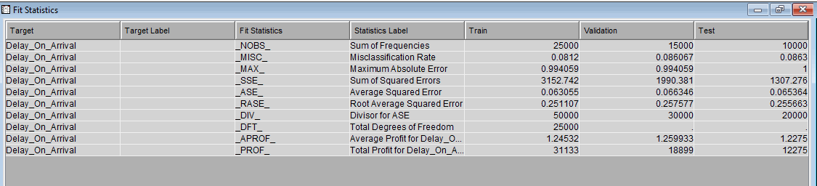
METHODS, RESULTS AND DISUCSSIONS
DECISION TREE MODEL
Fit Statistics Table

Slide 22
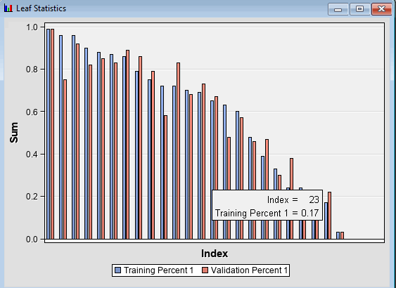
METHODS, RESULTS AND DISUCSSIONS
DECISION TREE MODEL
Leaf Statistics

Slide 23
TRANSFORMATION VARIABLE node options for MODEL 2: DECISION TREE (2)
DEFAULT METHODS
INTERVAL INPUTS – Maximum Normal
INTERVAL TARGETS– None
CLASS INPUTS – Maximum Normal
CLASS TARGETS– None

Slide 24
MODEL 2: DECISION TREE(2)
MODEL SELECTION CRITERION FOR TREE GROWTH AND PRUNING
Splitting Rule (Growing the tree using training data)
ProbChisq
Pruning criterion (Method for selecting optimal tree size using validation data)
Method – Assessment
Assessment Measure – Average Square Error

Slide 25
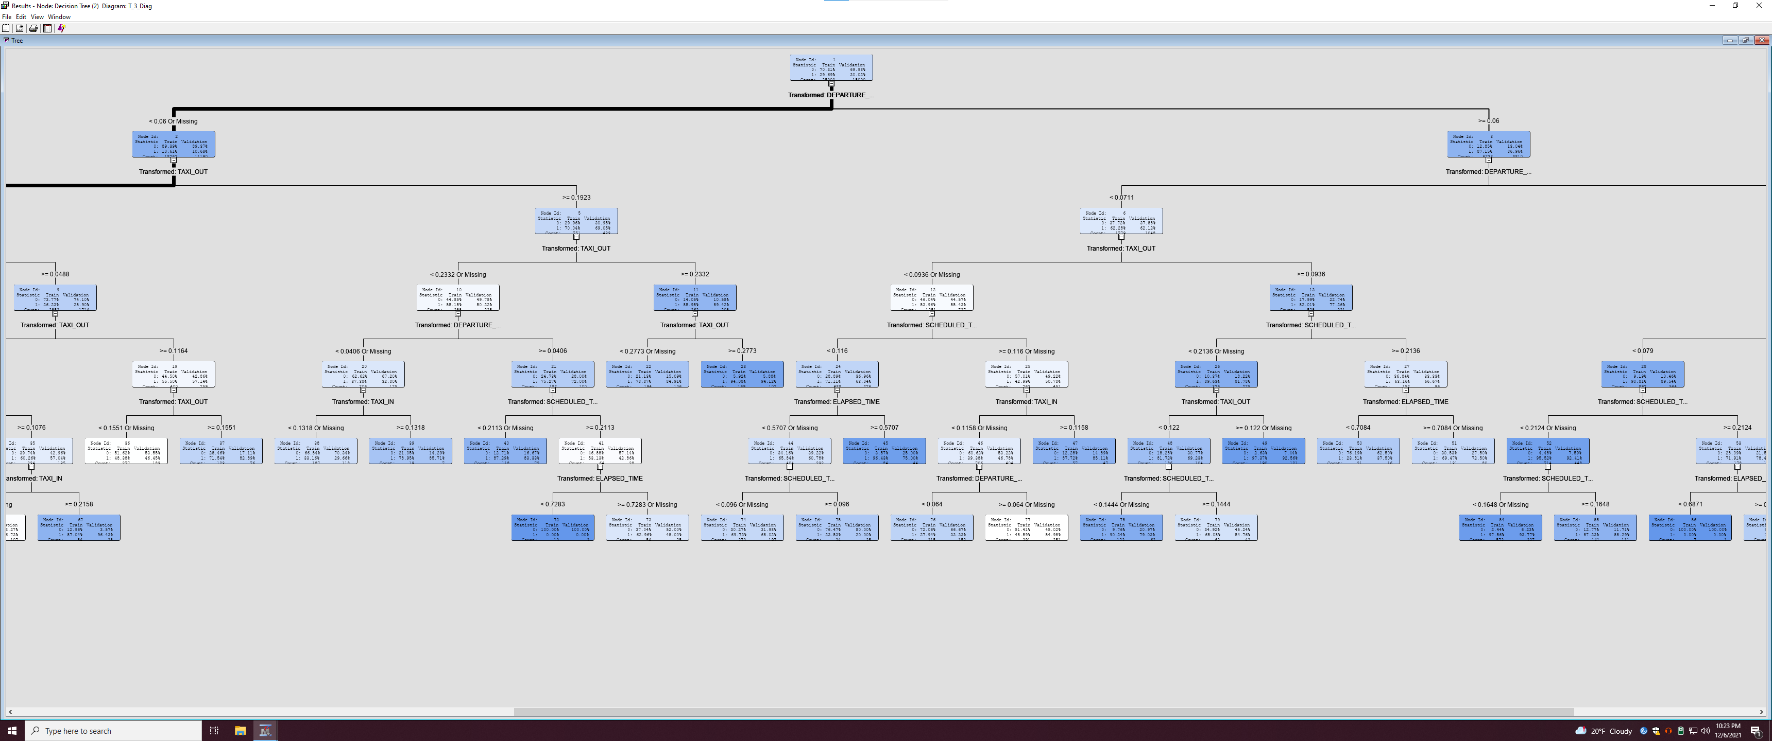
METHODS, RESULTS AND DISUCSSIONS
DECISION TREE (2) MODEL
Tree Diagram

Slide 26
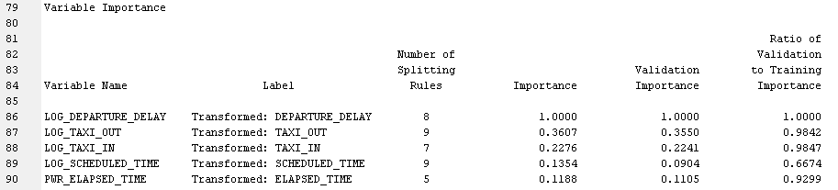
METHODS, RESULTS AND DISUCSSIONS
DECISION TREE(2) MODEL
Variable Importance from Output

Slide 27
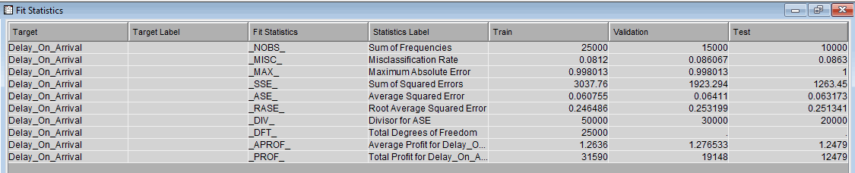
METHODS, RESULTS AND DISUCSSIONS
DECISION TREE MODEL
Fit Statistics Table

Slide 28
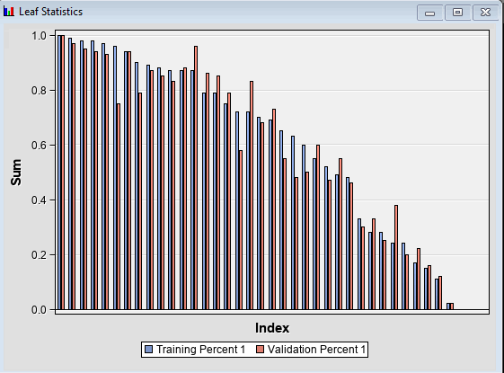
METHODS, RESULTS AND DISUCSSIONS
DECISION TREE(2) MODEL
Leaf Statistics

Slide 29
Imputation node options for the two regression models
CLASS VARIABLE
DEFAULT INPUT METHOD– Tree
DEFAULT TARGET METHOD– None
NORMALIZE VALUES - Yes
INTERVAL VARIABLE
DEFAULT INPUT METHOD– Tree
DEFAULT TARGET METHOD– None

Slide 30
MODEL 3: REGRESSION
MODEL SELECTION CRITERION
REGRESSION TYPE – Logistic Regression
LINK FUNCTION – Logit
SELECTION MODEL – Stepwise
SELECTION CRITERION – Akaike Information Criterion (AIC)

Slide 31
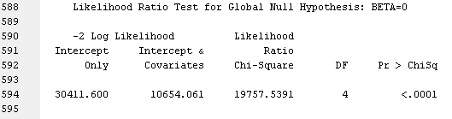
METHODS, RESULTS AND DISUCSSIONS
REGRESSION MODEL
Likelihood Ratio Test for Testing Global Hypothesis

Slide 32
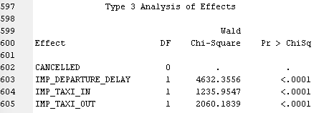
METHODS, RESULTS AND DISUCSSIONS
REGRESSION MODEL
Type 3 Analysis of Effect

Slide 33
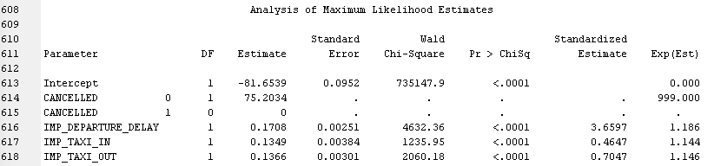
METHODS, RESULTS AND DISUCSSIONS
REGRESSION MODEL
Analysis of Maximum Likelihood Estimates

Slide 34
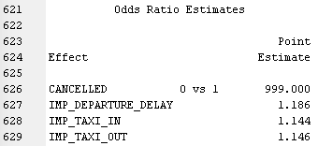
METHODS, RESULTS AND DISUCSSIONS
REGRESSION MODEL
Odds Ratio Estimates

Slide 35
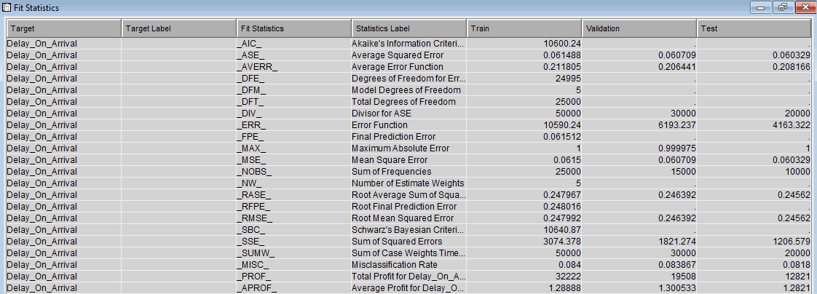
METHODS, RESULTS AND DISUCSSIONS
REGRESSION MODEL
Fit Statistics

Slide 36
TRANSFORMATION VARIABLE node options for MODEL 4: regression (2)
DEFAULT METHODS
INTERVAL INPUTS – Maximum Normal
INTERVAL TARGETS– None
CLASS INPUTS – Maximum Normal
CLASS TARGETS– None

Slide 37
MODEL 4: REGRESSION (2)
MODEL SELECTION CRITERION
REGRESSION TYPE – Logistic Regression
LINK FUNCTION – Logit
SELECTION MODEL – Stepwise
SELECTION CRITERION – Validation Misclassification

Slide 38
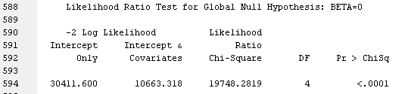
METHODS, RESULTS AND DISUCSSIONS
REGRESSION (2) MODEL
Likelihood Ratio Test for Testing Global Hypothesis

Slide 39
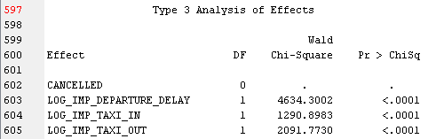
METHODS, RESULTS AND DISUCSSIONS
REGRESSION (2) MODEL
Type 3 Analysis of Effect

Slide 40
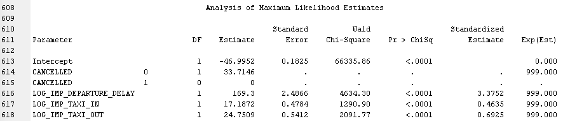
METHODS, RESULTS AND DISUCSSIONS
REGRESSION (2) MODEL
Analysis of Maximum Likelihood Estimates

Slide 41
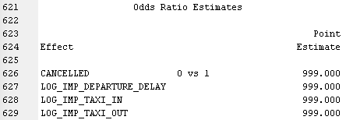
METHODS, RESULTS AND DISUCSSIONS
REGRESSION (2) MODEL
Odds Ratio Estimates

Slide 42
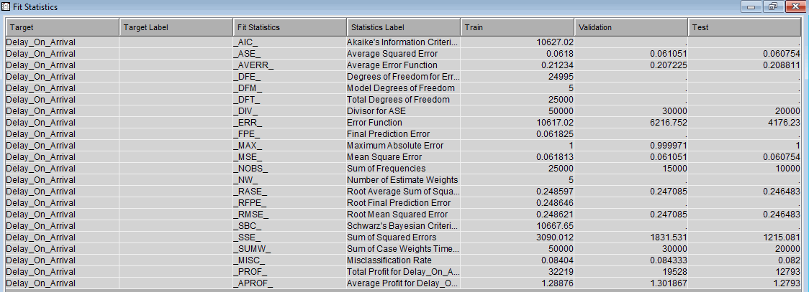
METHODS, RESULTS AND DISUCSSIONS
REGRESSION (2) MODEL
Fit Statistics

Slide 43
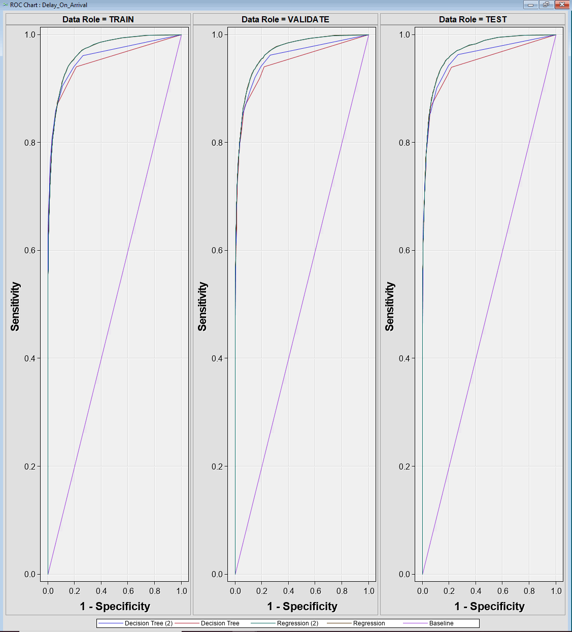
METHODS, RESULTS AND DISUCSSIONS
MODEL COMPARISON
ROC CHART

Slide 44
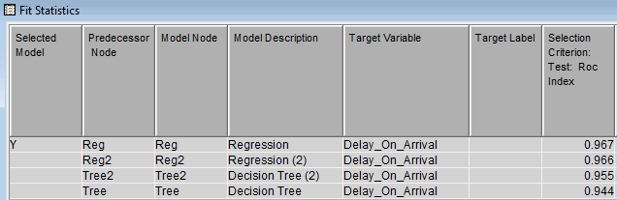
METHODS, RESULTS AND DISUCSSIONS
MODEL COMPARISON
Fit Statistics

